Slide 1
Research actions and thoughts

Slide 2
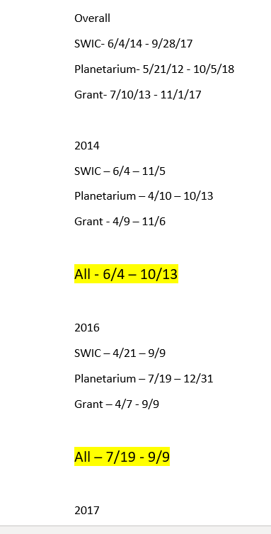
Deciding on years & periods
Started off by finding overall years that each location recorded information.
Aside 2015, all locations shared information for 2014, 2016, & 2017.
For each year, I decided the duration to cover based on the latest date that a location began to record data to the earliest date that a location stopped recording information.
2014: June 4 to October 13
2016: July 19 to September 9
2017: July 6 to September 28

Slide 3
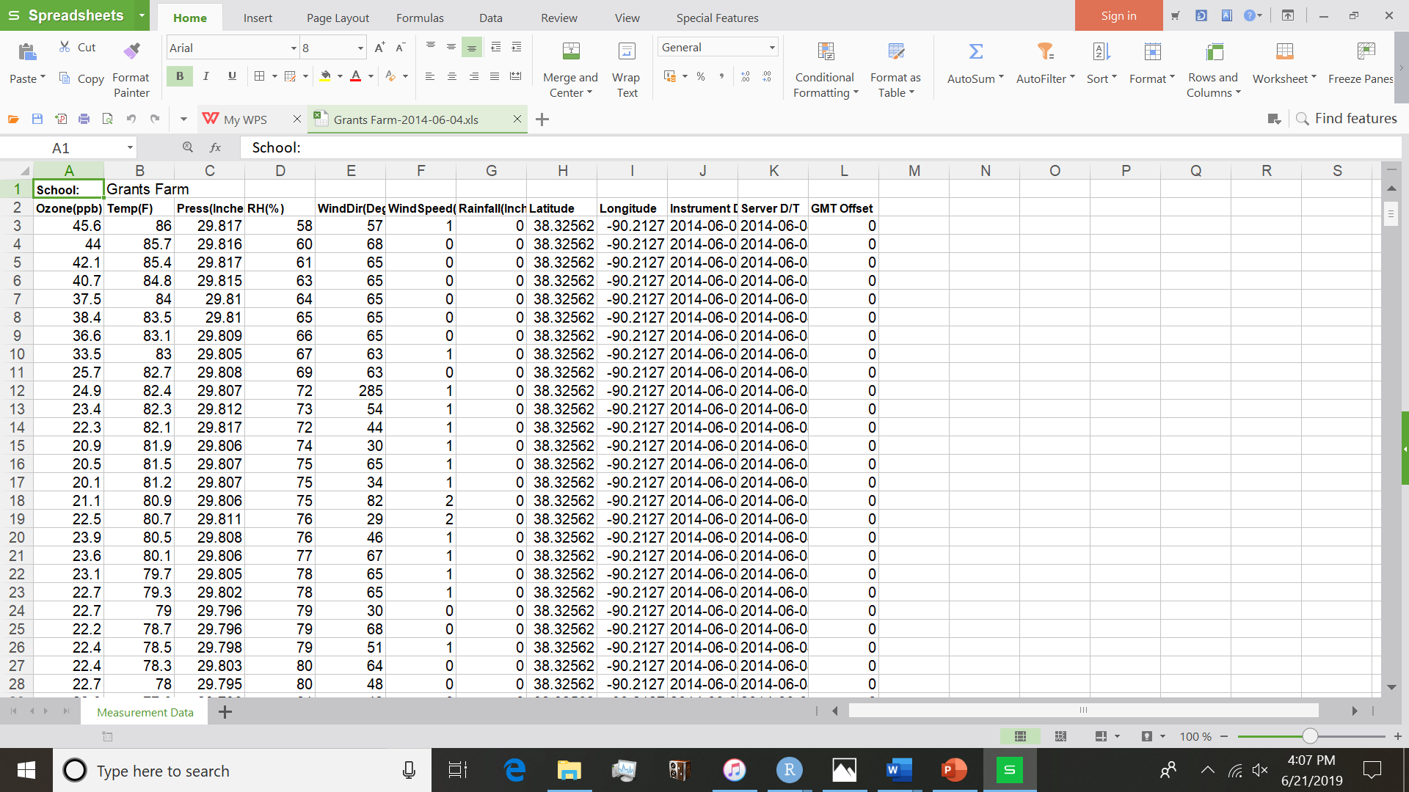
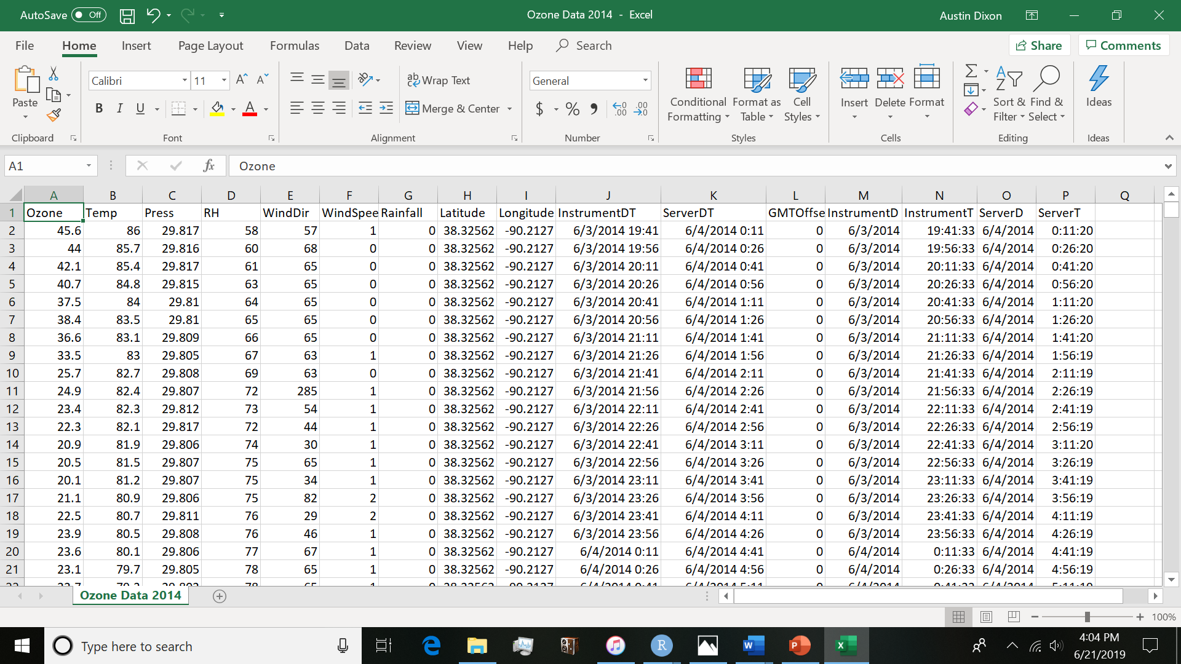
Dataset manipulations
Began with 9 spreadsheets that were condensed to 3. Modifications follows methodology of 2015 data edits.
For all three years, information for the 3 sites were combined in order of location.
Grant -> SWIC -> Planetarium
School name and title were removed for better use with R and other languages
Column names were shortened for easier use in R and other languages
Additional columns were created separate date/time variables if needed
Data is renamed for easier access & better representation of data represented
Files are converted to CSVs for accessible use in programming languages

Slide 4
Usage of R
Performed a prescreening summary statistics for each year but most analysis was performed on the 2014 data

Slide 5
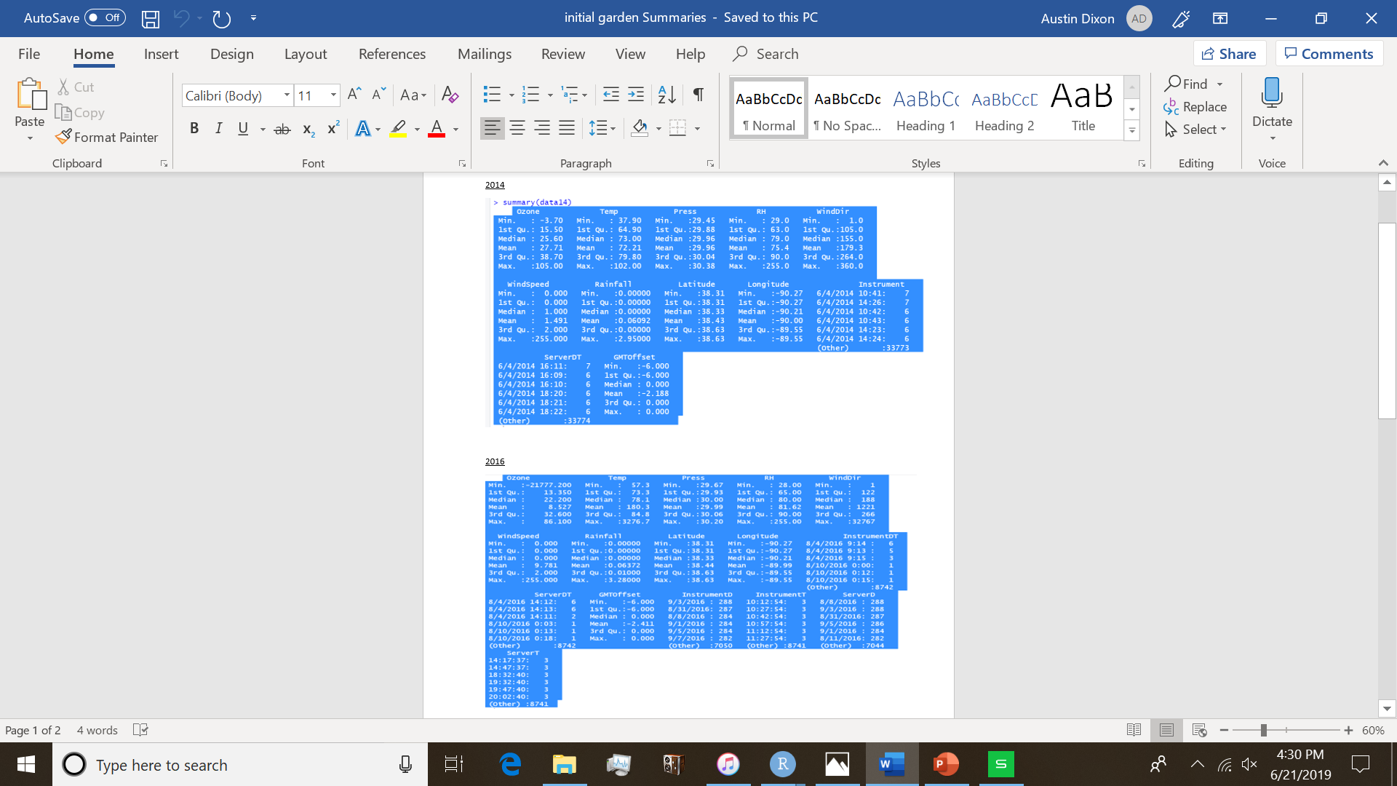
Prescreening
Data for each year were imported into R and ran with summary() for a quick analysis of what information is inside dataset.
Certain variables were taken into account for extreme/impossible values within the set.
Temperatures beyond 1,000 degrees
Ozone reading under 0 in the 10,000s
Relative humidity beyond 100%
Windspeeds beyond those of a devasting (F4) tornado on initial/ending readings

Slide 6
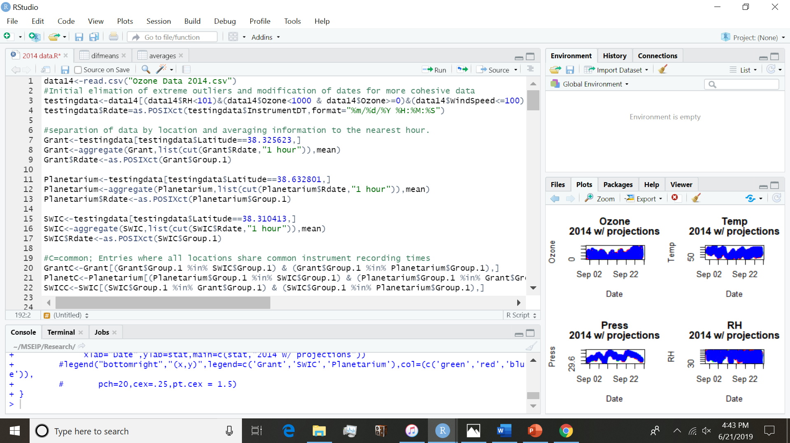
Data initialization
Data is original read into a single variable (data14 in this instance)
The data is then subsetted into a separate variable of “valid” entries:
Humidity must be at most 100
Ozone must be less than 1,000 but more than 0 (non-negative)
Windspeeds are less than 100 mph
A new attribute is added to the data to create a readable variation of the instrument reading dates for R to use (Rdates)

Slide 7
Initial subgrouping
The created variable for as our “testing data” is further sub-grouped by location, with each location named as their destination from the recorded latitude for each entry
For later comparative analysis and lack of consistency between recording times, the subsets are condensed to hourly averages of the each variable.
This resulted in a Group.1 variable being created for the aggregated times as a date-type variable
This also, unfortunately, resulted to the loss of all the other date/time variables.
Later attempts towards making graphics with the date variable resulted in complicacies so the dates were again converted to a POSIXct type in a separate dataset attribute (Rdate again)

Slide 8
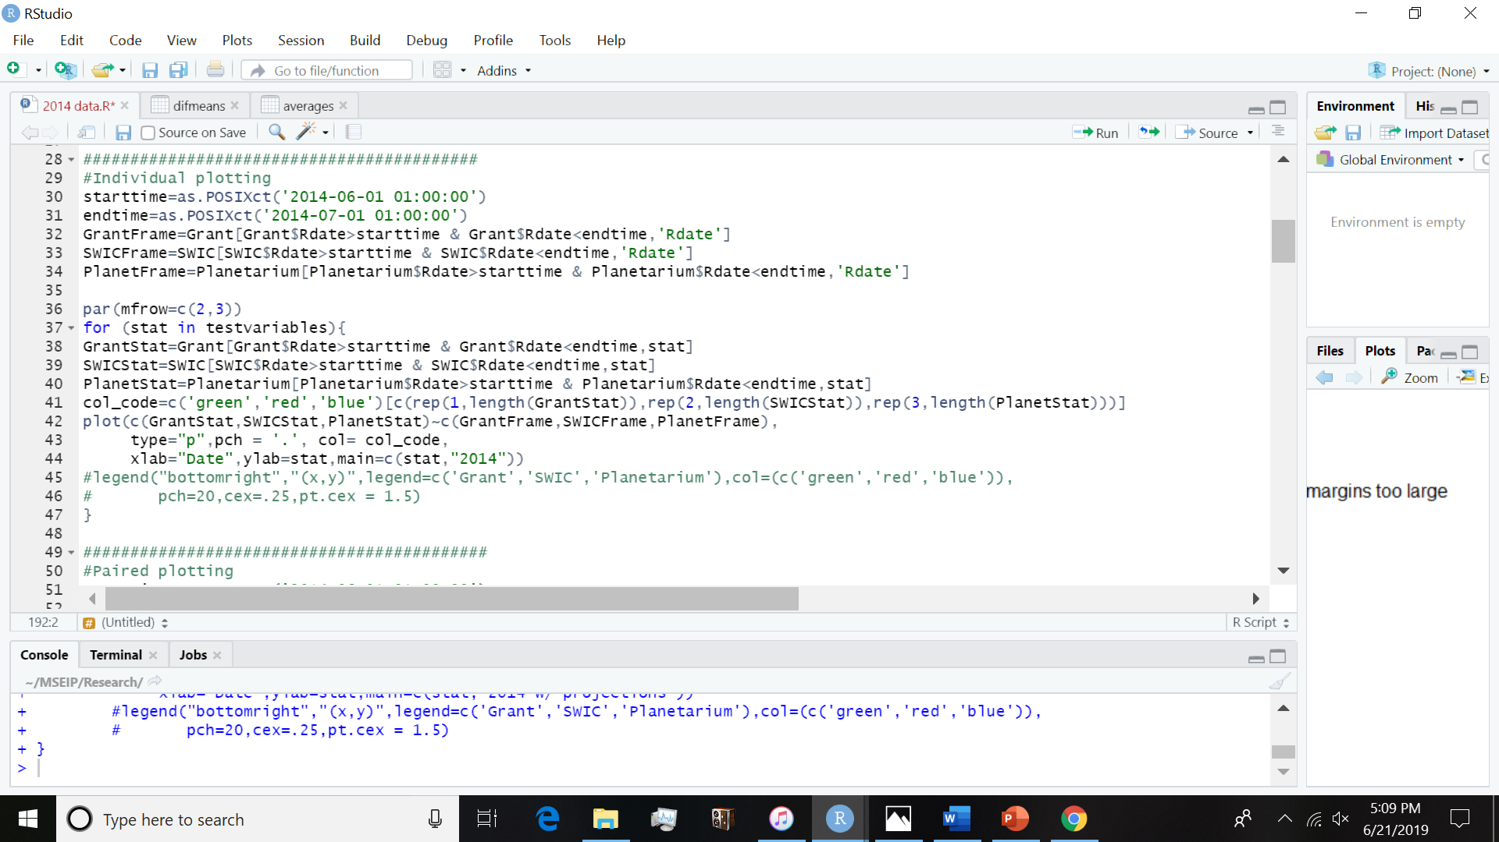
First Plots
Various variables are plotted over the course of time in the growth period .
Variables are: Ozone, Temperature, Pressure, Relative Humidity, Wind speed and direction.
Rainfall was also taken into account but removed for quality of graphics
First, starting and ending dates are parameterized to set distinct dates of interest. Subgroups of each location were then created to find the entries within the selected dates.
Graphs are then plotted using the sub-grouped data by variables and are assigned by color
Grant = Green
SWIC = Red
Planetarium = Blue

Slide 9
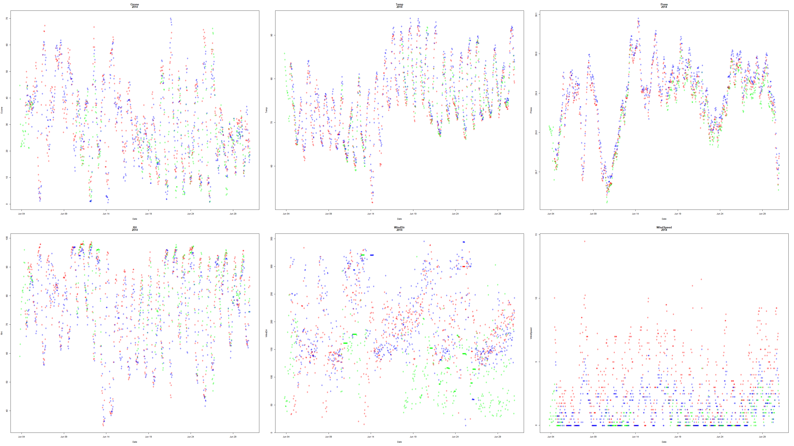

Slide 11
Also noticed in the data for 2015, certain locations (primarily Grant Farm) were missing information over significant periods of time. A topic/question of interest that had developed is if it is possible to use the data for other sites fill in data gaps for specified sites.

Slide 12
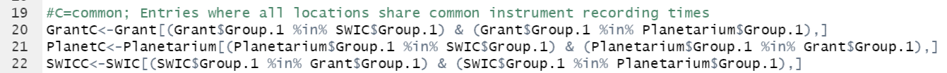
Missing data projections: initialization
To begin my attempt at filling in the missing data, I sub-grouped the data from each location into groups comprised of entries that each location had a recording for a specific time.
I.e. Each location has an entry for 06/04/2014 12:00:00 and so on

Slide 13
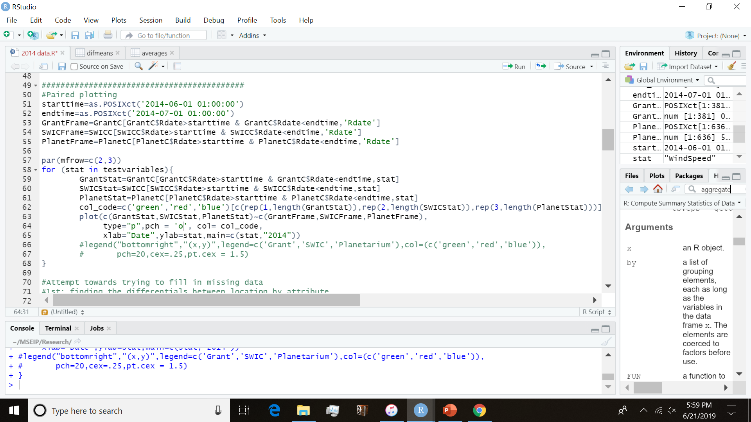
Paired graphics
I then followed a similar coding structure to the first plotting example for plotting the paired-date information to display better the holes within the data.

Slide 14
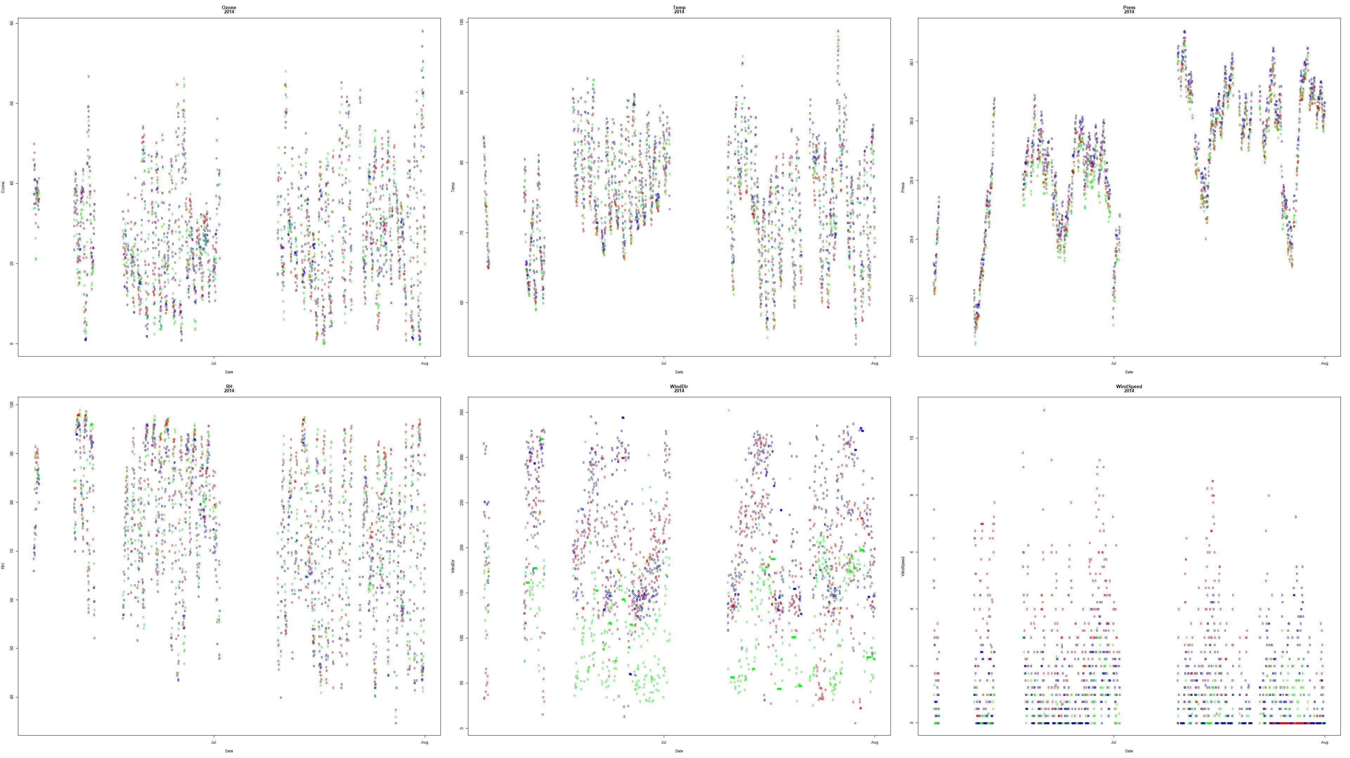

Slide 16
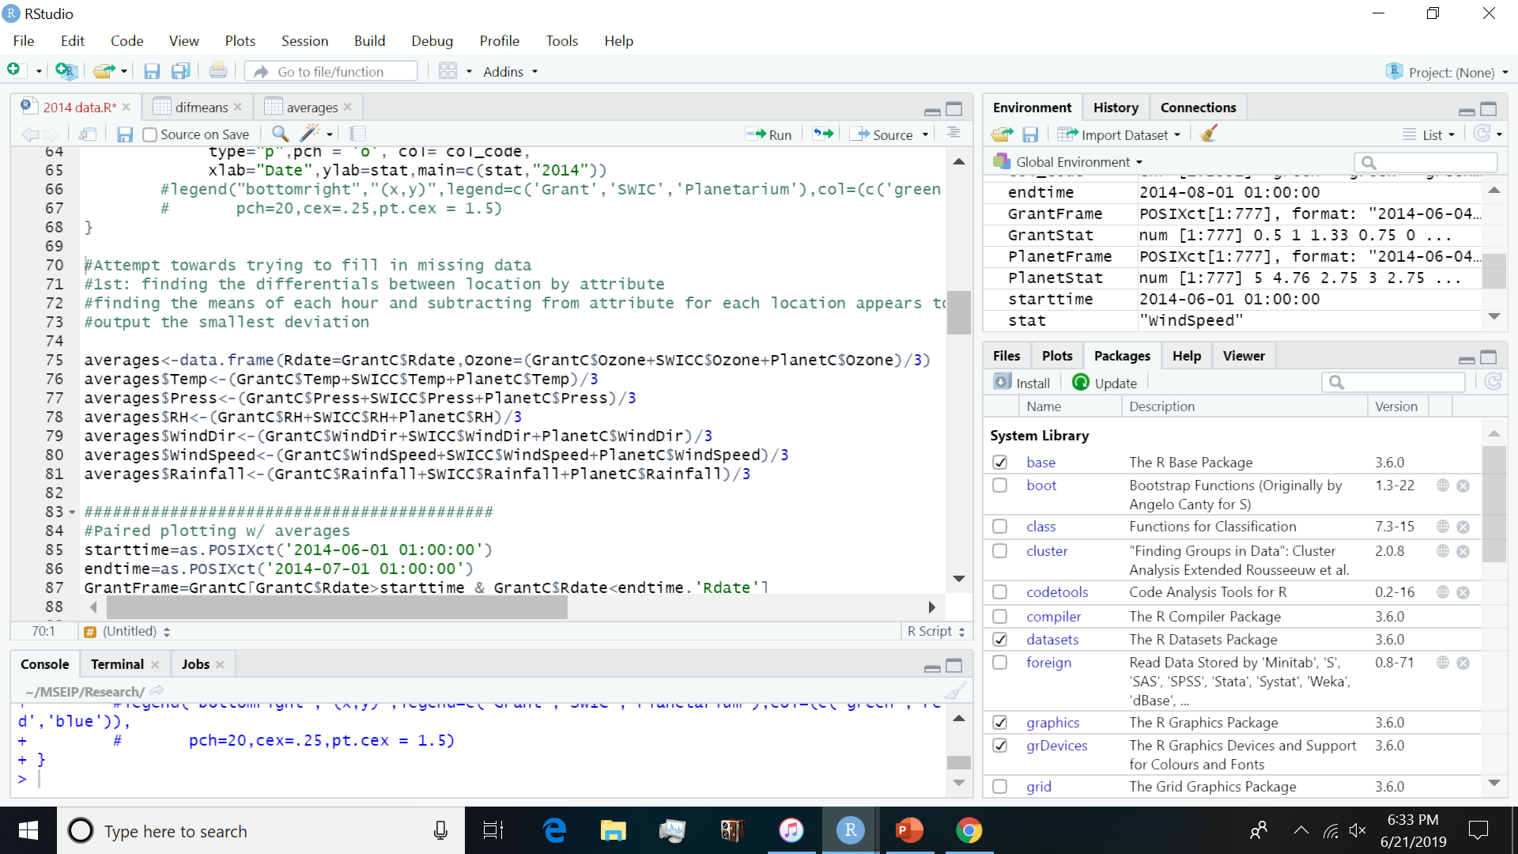
Selecting a reference: Time Averages
My initial idea is the use differentials towards predicting a statistic at a given time. I began with comparing the sites to each other, one by one (Grant - SWIC, etc.) to see which comparisons yielded to least variability to the obtained differentials (by standard deviation). The results of which were varied.
I then attempted to reduce variability by seeing if using the midpoint of the two other sites (Grant – ((SWIC + Planetarium)/2) to see if the yield could produce a closer set of differentials. The result also varied, some producing closer sets while some actually being more varied.
Finally, I tried finding the average among all sites for a time period then subtracting it from each respective reading. This resulted in a significantly smaller standard deviation for each outcome so I decided to us it as the basis of comparison.
I then created a dataset composed of the shared hourly averages of each variable from each location.

Slide 17
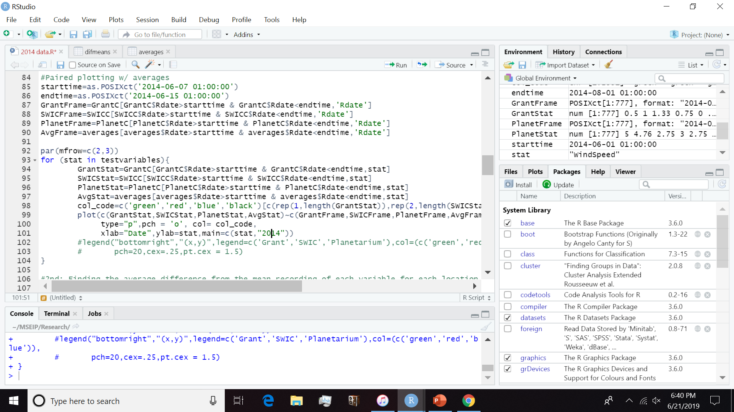
Reference Graph
To see whether how well these averages correlate with the actual information, I plotted the hourly averages with the data as black colored points.

Slide 18
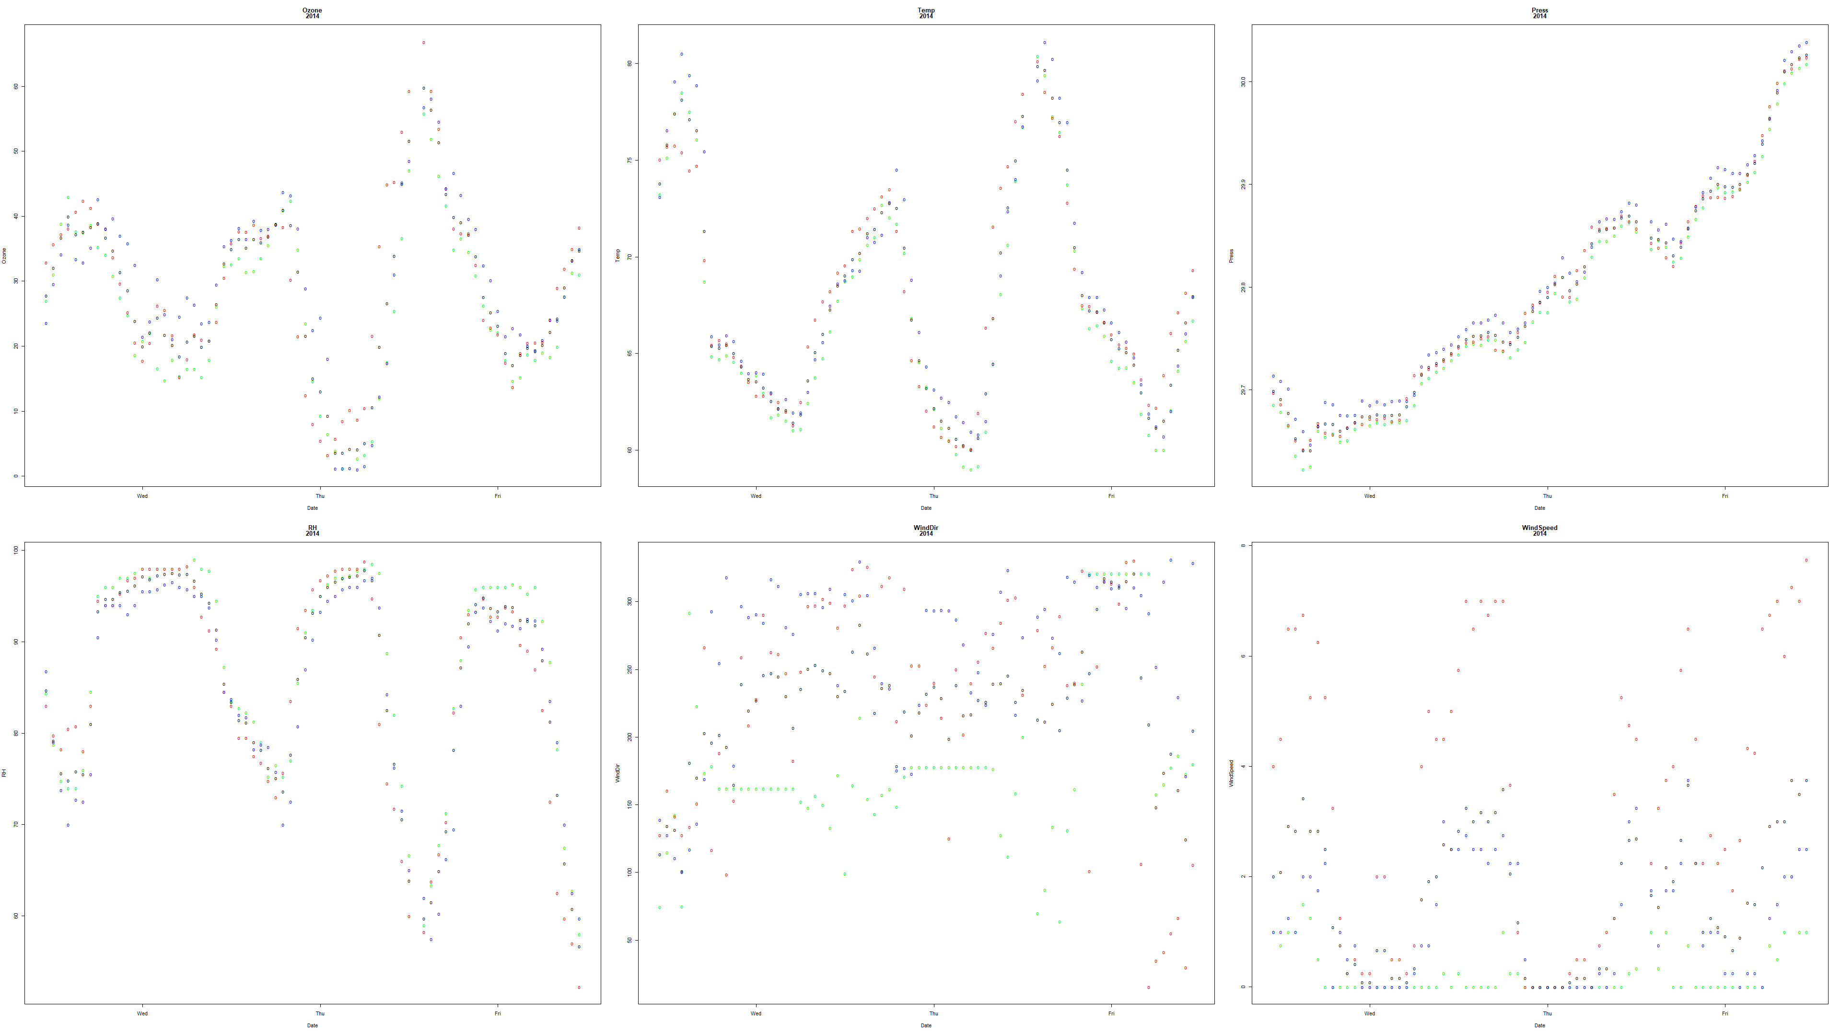

Slide 20
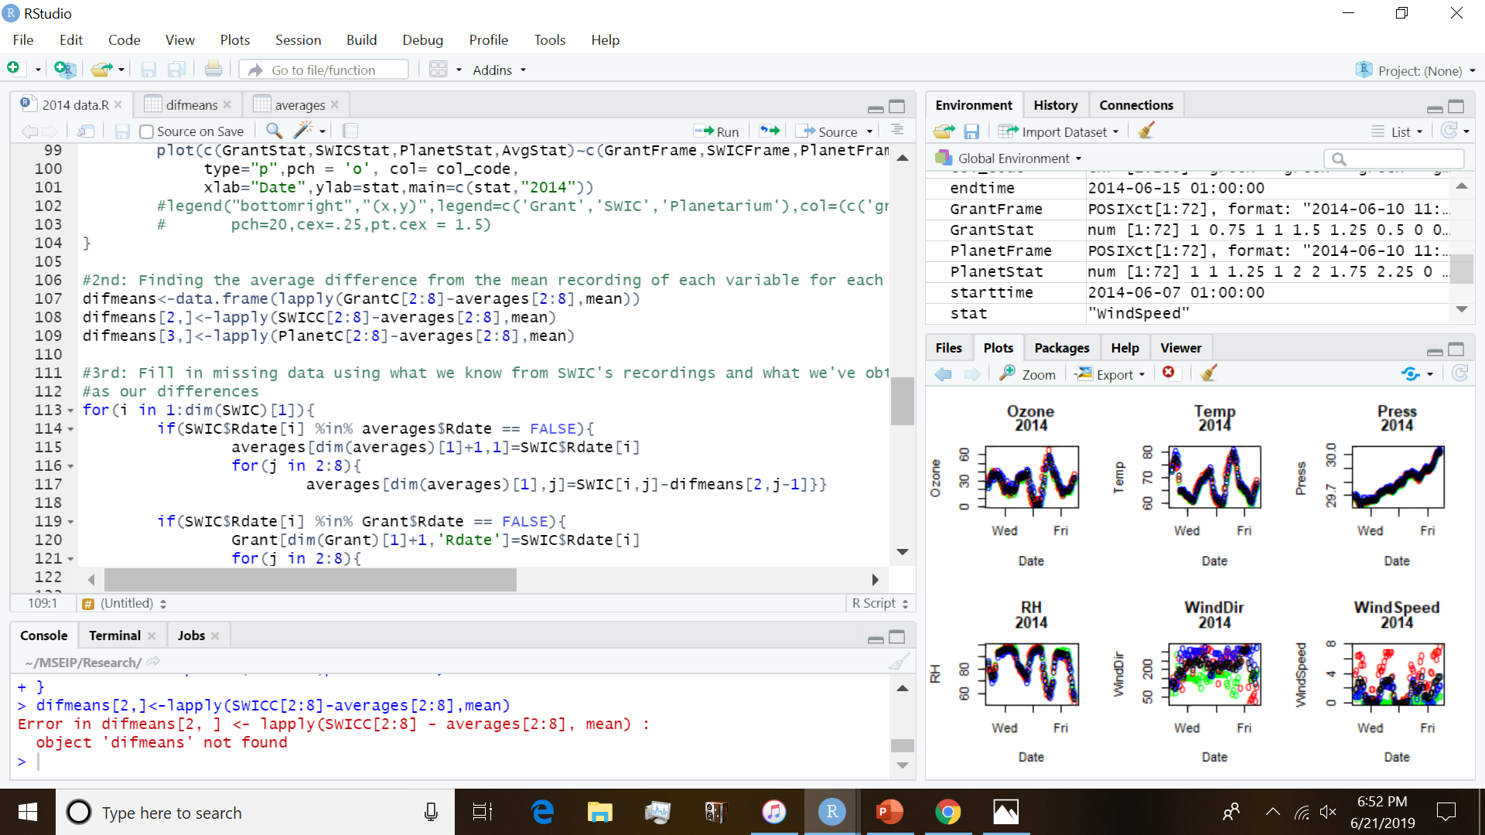
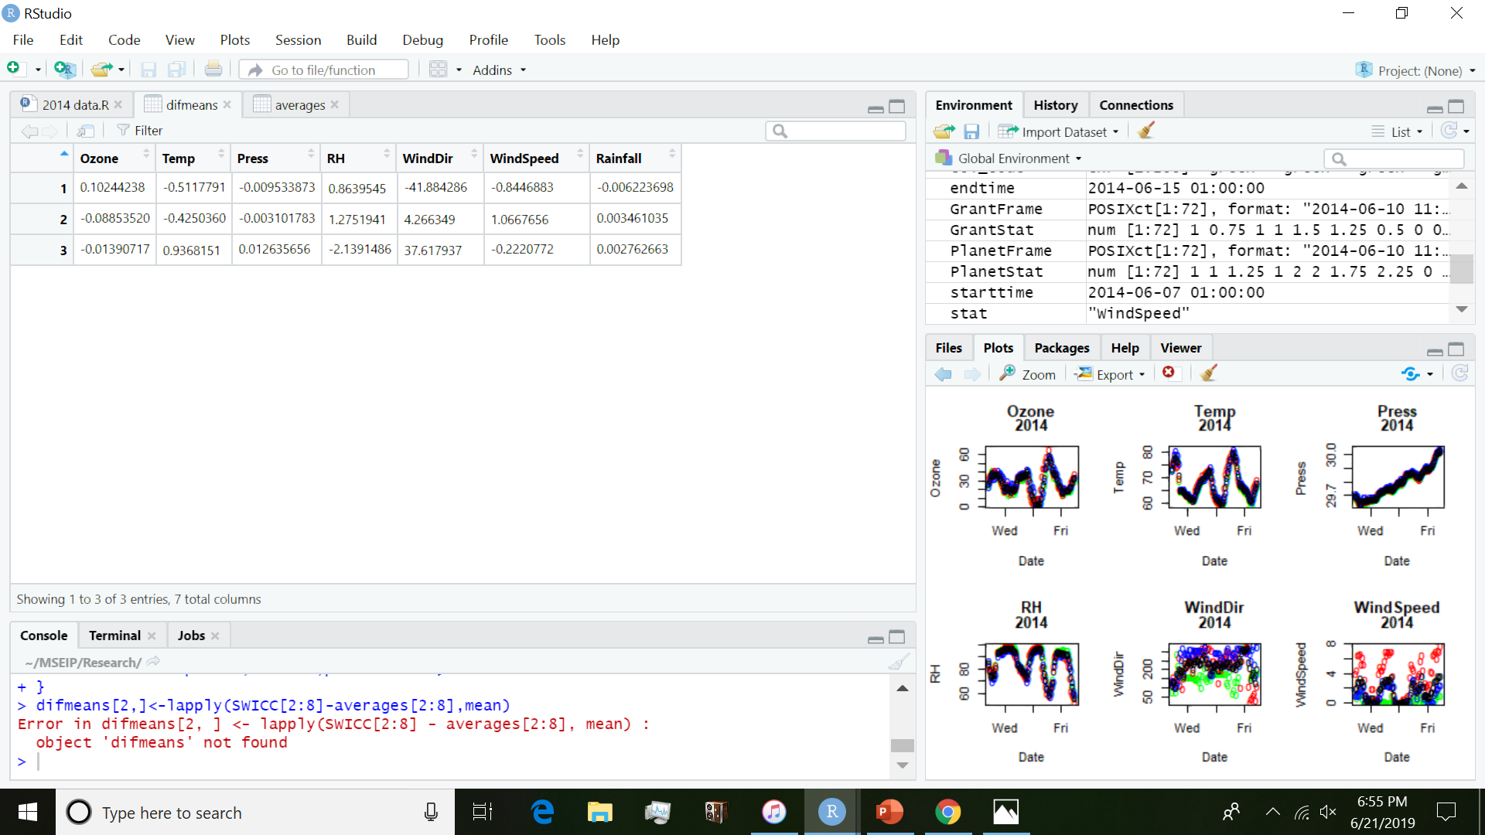
Recoding the differentials
I then recorded the average differentials of variable by location and stored it in a dataset. The first entry indicates the Grant differential, the second represents SWIC, and the final representing the Planetarium’s differentials.

Slide 21
Data projections
SWIC possessed the most entries hourly over the course of the recording period so it was used first as a basis in predicting missing information data in the other datasets. All missing data projections are placed on the bottom of hourly averages and first subsets by location. This process is later applied with using the information from the locations to receive a “fuller” set of data to observe.

Slide 22
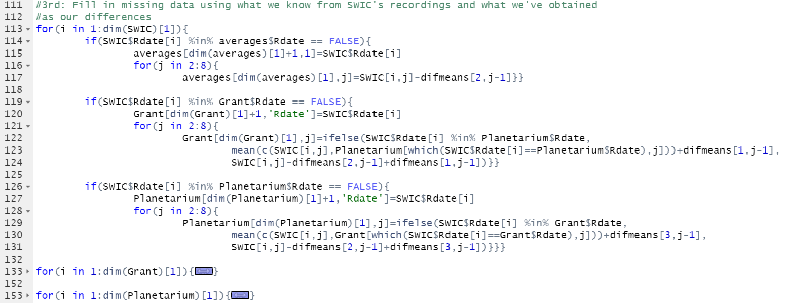
Cont.
Averages for each variable were collected by subtracting the average differentials from the recording found by the data being projected from.
Projecting onto other sites is a bit more complex. If information is found the other two sites on a specific hour interval, then the program finds the midpoint of the given statistic for that hour then applies the average differential for the location being projected onto. Otherwise, the projection follows similar to how averages where calculated, first subtracting the differential of the projector data to get to the “average” then adding the projected location’s differential to obtain a predicted value.
This may not be the most accurate way to account for the missing data. It does, however, provide on some account a basis on how the data could look for each location by the hour.

Slide 23
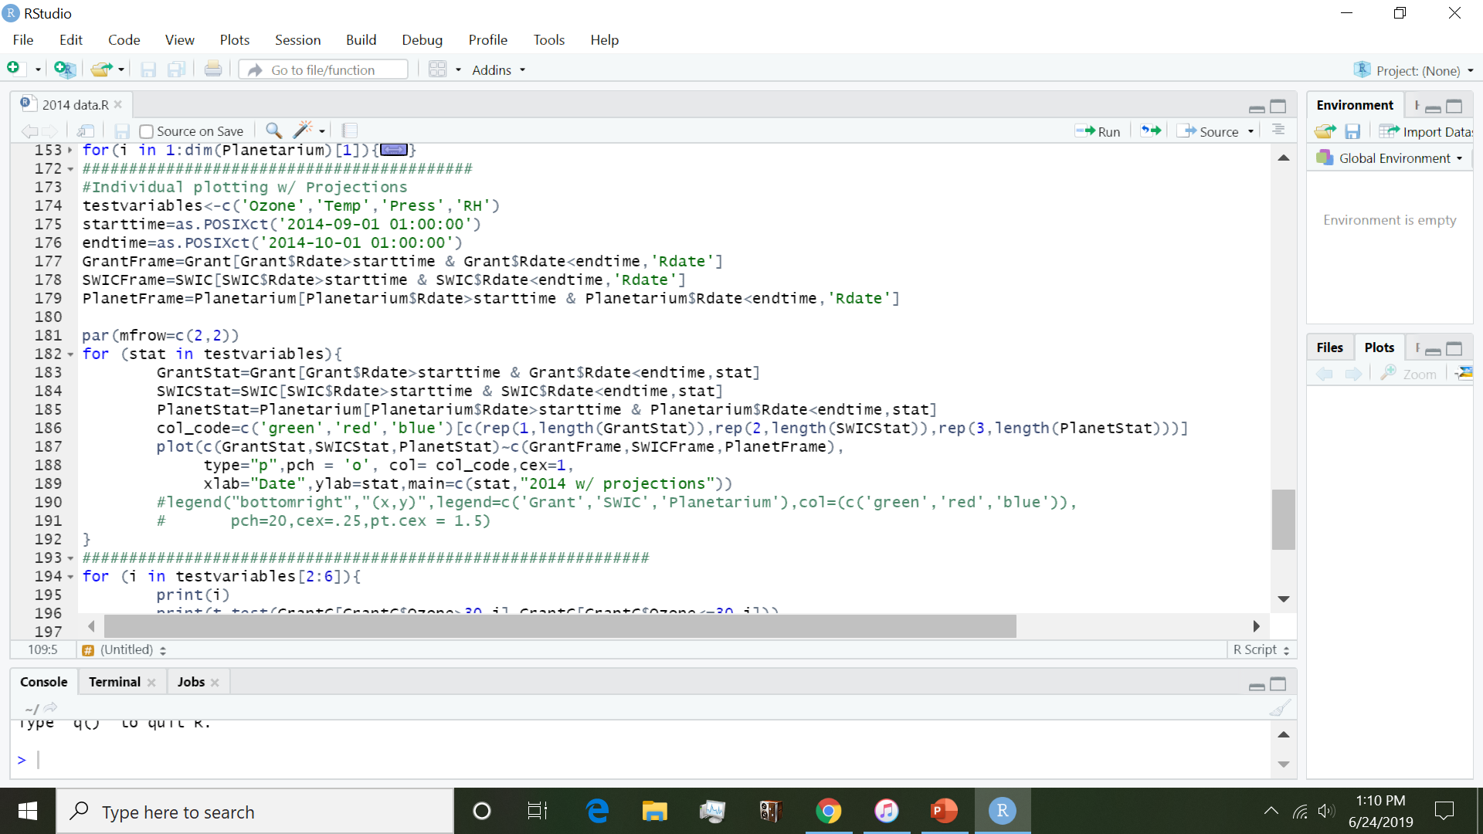
Projection Graphs
Lastly, I plotted the original location datasets with their projections to see if the projections were plausible at least and what could use some work.
Due to the nature of the wind variables becoming negative due to overwhelming differentials, their graphs were not accounted for until further modifications are made.
Primarily near the end of October, the Planetarium’s projection appears to over-project each variable.

Slide 24
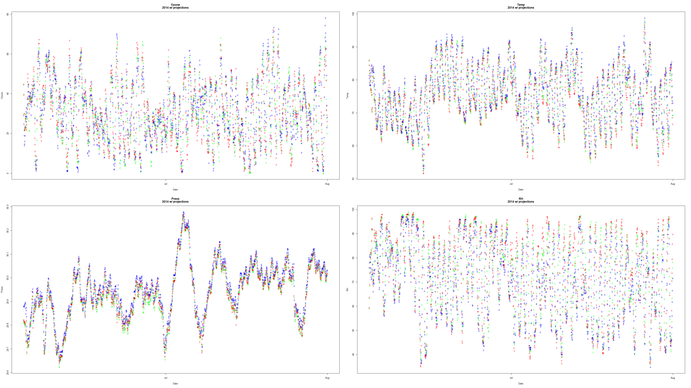

Slide 25
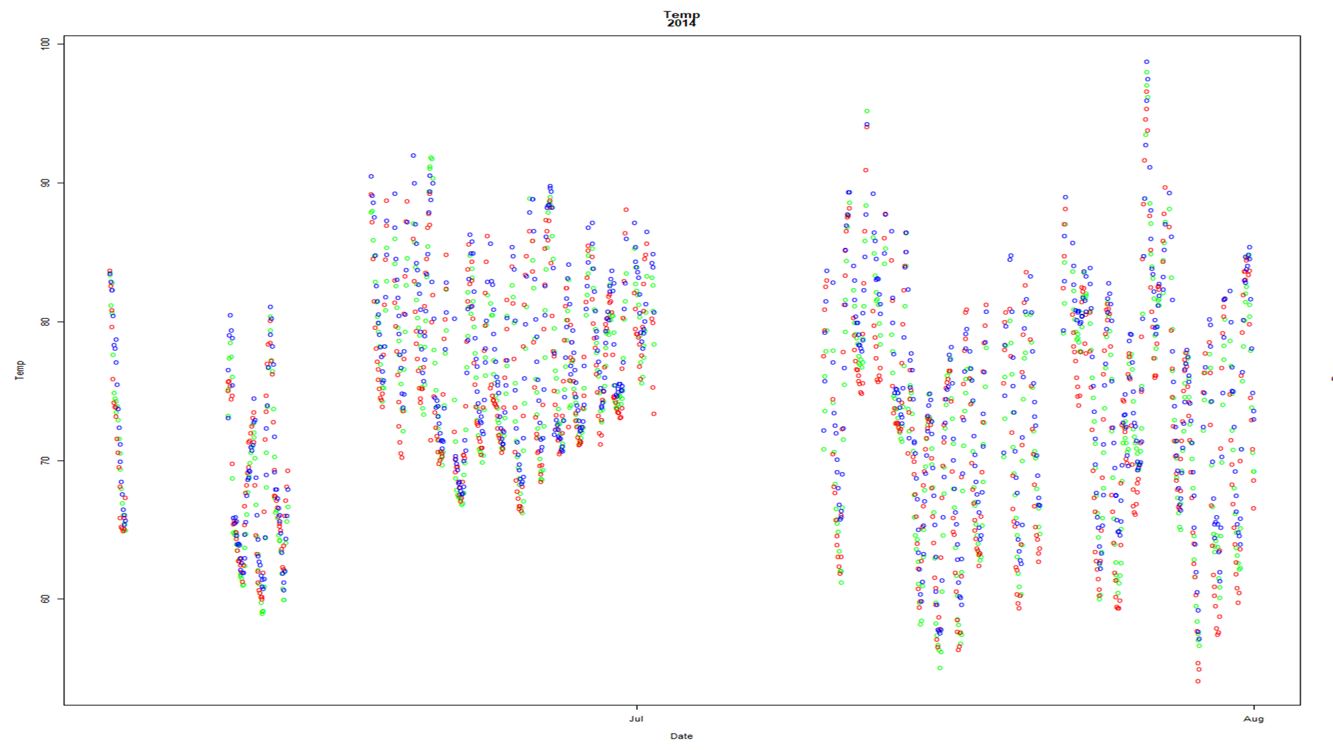

Slide 26
